Slide 1

Guiding through a typical
Machine Learning Pipeline

Slide 2
Michael
The Standard Machine Learning Pipeline is derived from the CRISP-DM Model
1
Datasets
ML Algorithm
Data Retrieval
2
Data Preparation & Feature Engineering
3
4
Data Processing & Wrangling
Feature Extraction & Engineering
Feature Scaling & Selection
Modeling
Model Evaluation & Tuning
Satisfactory Perfor-mance?
No
Yes
5
Deployment & Monitoring
Source: Practical Machine Learning with Python

Slide 3
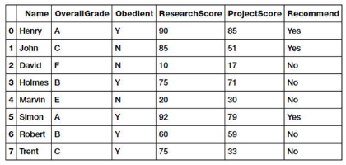
1
2
3
4
5
Michael
Data Retrieval
Raw Data Set
Data Retrieval is mainly data collection, extraction and acquisition from various data sources and data stores.
Data Sources or Formats, e.g.:
CSV
JSON
XML
SQL
SQLite
Web Scraping (DOM, HTML)
Data Descriptions:
Numeric
Text
Categorical (Nominal, Ordinal)
“
More data beats clever algorithms, but
better data beats more data.
“
Peter Norvig
Source: Practical Machine Learning with Python

Slide 4
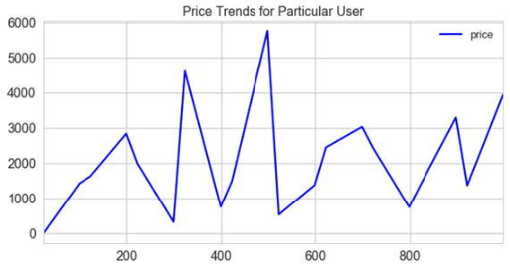
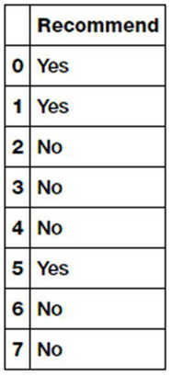
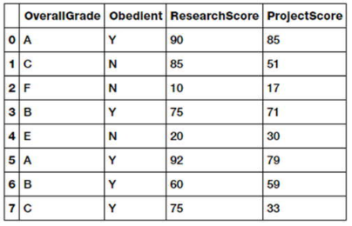
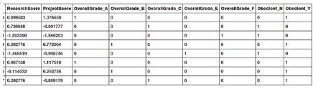
1
2
3
4
5
Data Visualization
Michael
Data Preparation & Feature Engineering
Purpose
Data outcome labels
In this step the data is pre-processed by cleaning, wrangling (munging) and manipulation as needed.
Initial exploratory data analysis is also carried out.
Dataset Features
Methods
Data Wrangling
Data Understanding
Filtering
Typecasting
Data Transformation
Imputing Missing Values
Handling Duplicates
Handling Categorical Data
Normalizing Values
String Manipulations
Data Summarization
Data Visualization
Feature Engineering, Scaling, Selection
Dimensionality Reduction
Feature set with categorical variables
Source: Practical Machine Learning with Python

Slide 5
1
2
3
4
5
Michael
Modeling
Model Types
Linear models
Logistic Regression
Naïve Bayes
Support Vector Machines
Non parametric models
K-Nearest Neighbors
Tree based models
Decision tree
Ensemble methods
Random forests
Gradient Boosted Machines
Neural Networks
Densely Neural networks (DNN)
Convolutional Neural networks (CNN)
Recurrent Neural networks (RNN)
Classification models
Binary Classification
Multi-Class Classification
Multi Label Classification
In the process of modeling, data features are usually fed to a ML method or algorithm and train the model, typically to optimize a specific cost function in most cases with the objective of reducing errors and generalizing the representations learned from the data.
Regression models
Simple linear regression
Multiple linear regression
Non linear regression
Clustering models
Partition based clustering
Hierarchical clustering
Density based clustering
Source: Practical Machine Learning with Python
Modelling Procedure
Initializing Parameters
Activation Function
Cost function, Metric definition
Train with # of epochs
Evaluate model with test data

Slide 6
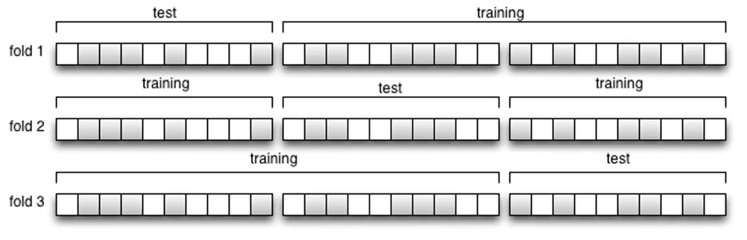
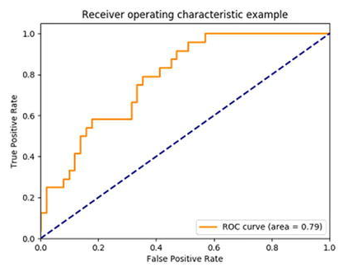
1
2
3
4
5
Michael
Evaluation & Tuning Methods [1]
3-fold cross validation
Purpose
Models have various parameters that are tuned in a process called hyper parameter optimization to gate models with the best and optimal results.
Methods
Classification models can be evaluated and tested on validation datasets (k-fold cross) and based on metrics like:
Accuracy
Confusion matrix, ROC
Regression models can be evaluated by:
Coefficient of Determination, R²
Mean Squared Error
Clustering Models can be validated by:
Homogeneity
Completeness
V-measures (combination)
Silhouette Coefficient
Calinski-Harabaz Index
ROC curve for binary and multi-class model evaluation
Source: Practical Machine Learning with Python

Slide 7
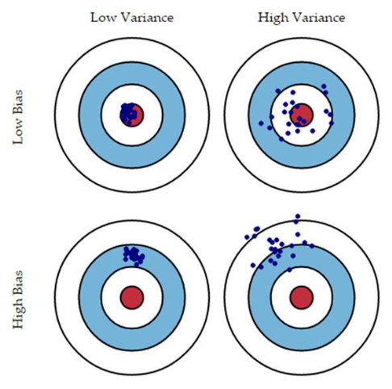
1
2
3
4
5
Michael
Evaluation & Tuning Methods [2]
Bias Variance Trade Off
Bias Variance Trade-Off
Finding the best balance between Bias and Variance Errors.
Bias Error is the difference between expected and predicted value of the model estimator. It is caused by the underlying data and patterns.
Variance errors arises due to model sensitivity of outliers and random noise.
Underfitting
Underfitting is seen as a parameter setup resulting in a low variance and high bias.
Overfitting
Overfitting is seen as a parameter setup resulting in a high variance and low bias.
Grid Search
Simplest hyper-parameter optimization method. Tries out a predefined grid of hyper parameter set to find the best.
Randomized Search
This is a modification of Grid Search and uses a randomized grid of hyper-parameter settings to find the best one.
Source: Practical Machine Learning with Python

Slide 8
1
2
3
4
5
Michael
Deployment & Monitoring
Deployment Persistence
Model Persistence is the simplest was of deploying
A model. The final model will persist on permanent media Like hard drive. A new program must route real-life data to the persistent model which creates the predicted output.
Custom Development
Another option to deploy a model is by developing the implementation of model prediction method separately. The output is just the values of parameters that were learned. Method for the software development domain.
Selected models are deployed in production and are constantly monitored based on their predictions and results.
In-House Model Deployment
Due to data protection reasons a lot of enterprises do not want to expose their data on which models need to be built and deployed. Models can be easily integrated internally with web dev frameworks, APIs or micro-services on top of the prediction models.
Model Deployment as a Service
Model is open accessible and can be integrated via a cloud based API request.
Source: Practical Machine Learning with Python

Slide 9


Contact
Special Thanks to the author team:
Dipanjan Sarkar
Raghav Bali
Tushar Sharma
Michael Gerke Detecon International GmbH
Sternengasse 14-16 50676 Cologne (Germany) Phone: +49 221 91611138 Mobile: +49 160 6907433 Email: Michael.Gerke@detecon.com

